Slide 1

RxJS 6.0 (Observable)
FormControl, Event Emitter & Http uses Observable API (Rx JS)

Slide 2
RX JS

Slide 3
Application Architecture
Oracle
Sql server
MongoDB
ORM
Hibernate
ADO.Net EF
Mongooose
(CRUD)
Spring REST
Web API
Express /Restify
Index.html
B A L
(RESTful Services)
Get , Post , Put, Delete
D A L
Custom modules
(InvoiceModule,PaymentModule…
Http
Enterprise App
Ajax (HttpModule)
Model
AuthService
ProductService
Read, Save, Update, Remove
LoggerService
ProductComponent
xyzComponent
Routing
Index.html
(SPA)
Guards

Slide 4
Without Promise
//widget.ts import * as $ from "jquery";
export function render(container: HTMLElement) {
// Imagine lots of widget code here.
// For this demo, $.text() will have to do.
$(container).text("Hello, widget!");
alert("Hello")
}

Slide 5
Without Promise
// because import() returns a promise which resolves once //the module is loaded
import * as ES6Promise from "es6-promise";
ES6Promise.polyfill();
async function renderWidget() {
// Locate the widget container <div id=“control"></div>
const container = document.getElementById(“control");
// If we found the container,
//import the widget and render it into the container
if (container !== null) {
const widget = await import(“./widget");
widget.render(container);
}
}
renderWidget();

Slide 6
Without Promise
// Via callbacks without Promise API
function doAsyncTask(cb) {
setTimeout(() => {
console.log("Async Task Calling Callback");
cb();
}, 1000);
}
doAsyncTask(() => console.log("Callback Called"));
console.log("I am not blocked.....")

Slide 7
With Promise
let error = false;
function doAsync() {
return new Promise((resolve, reject) => {
setTimeout(() => {
if (error) {reject('error');}
else { resolve('done');
}
}, 1000);
});
}
doAsync().then(
(val) => console.log(val),
(err) => console.error(err)
);

Slide 8
With Promise and Handle errors
// Immediately Resolved Promise
let promise = Promise.resolve('done');
promise.then((val) => console.log(val)); // 'done'
// Handling Errors with nested promise
Promise.resolve('done')
.then((val) => {throw new Error("fail")})
.then((val) => console.log(val))
.catch((err) => console.error(err));

Slide 9
Stream
Streams are a sequence of values over time.
For example a number that goes up by 1 every second might have a stream that looks like [0,1,2,3,4]
Another stream might be a sequence of x and y positions of mouse click events, like so:
[(12,34), (345,22), (1,993)]
Or JSON array: [
{ "name": “Sri" }, { "name": “Murthy" },
{ "name": “Raju" }, { "name": "Asim" }
]

Slide 10
Observable
A Stream?
- A Sequence of ongoing events ordered in time
- Emits a value , error and complete signal
Indicates an error
X
Indicating event with value
(click)
Indicates
Stream has
completed

Slide 11
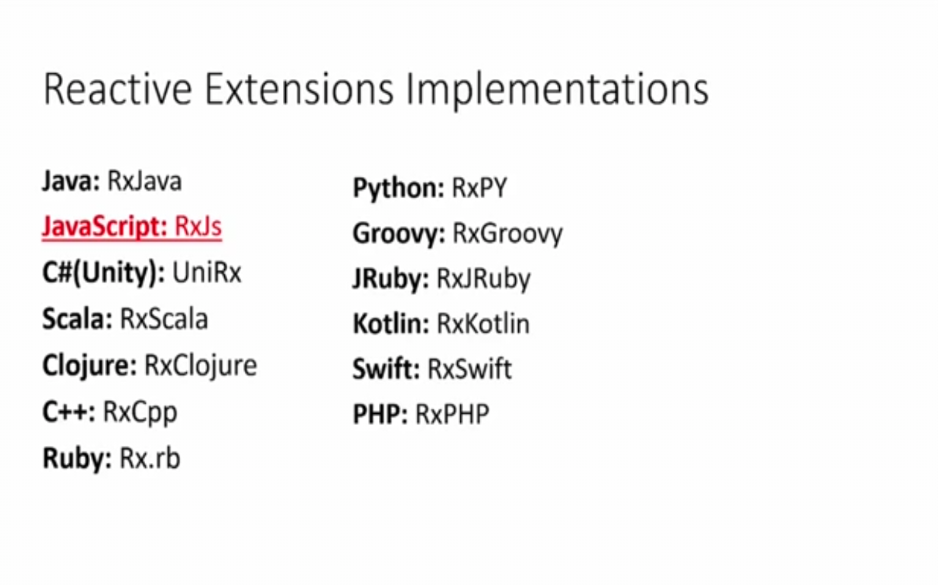
Reactive eXtensions (RX)
What is Reactive Programming?
Programming paradigm that works with asynchronous data streams.
Makes handling events easier
Data streams can be created from many things
UI events
Http Requests
File systems
Array-like Objects
Memory / cache

Slide 12
Observable
RxJS 6 brings improvements in modularity, a boost in performance and easier to debug call stacks.
The RxJS team has made a solid effort on making this release as backward compatible as possible

Slide 13
Observable
RxJS 6 Backward Compatibility
To make the migration path from RxJS 5 to RxJS 6, the RxJS team has released a sibling package called rxjs-compat.
This package creates a compatibility layer between the APIs of v6 and v5.
>npm install rxjs@6 rxjs-compat@6 --save

Slide 14
Observable
rxjs/operators: Contains all pipeable operators.
rxjs: Contains creation methods, types, schedulers, and utilities.
import { Observable, Subject, asapScheduler, pipe, of, from, interval, merge, fromEvent } from 'rxjs';
rxjs/operators: Contains all pipeable operators.
import { map, filter, scan } from 'rxjs/operators';

Slide 15
Observable
rxjs/webSocket: Contains the web socket subject implementation.
import { webSocket } from 'rxjs/webSocket';
rxjs/ajax: Contains the Rx ajax implementation.
import { ajax } from 'rxjs/ajax';
rxjs/testing: Contains the testing utilities for RxJS
import { TestScheduler } from 'rxjs/testing';
.

Slide 16
Observable
Observables is a new primitive type which acts as a blueprint to create streams, subscribe to them, react to new values, and combine streams together to build new ones.
RxJS stands for *R*eactive E*x*tensions for *J*ava*S*cript, and its a library that gives us an implementation of Observables for JavaScript

Slide 17
Observable
Communicating between components with Rxjs:
Observable.subscribe()
The observable subscribe method is used by angular components to subscribe to messages that are sent to an observable.
Subject.next()
The subject next method is used to send messages to an observable which are then sent to all angular components that are subscribers (a.k.a. observers) of that observable.

Slide 18
RXJS
Reactive Extensions for JavaScript (RxJS) is a reactive streams library that allows to work with asynchronous data streams with Observable.
RxJS can be used both in the browser or in the server-side using Node.js.
Angular prefers Observables instead of Java script Promises for Http and Form data.
Observable
A sequence of items that arrive asynchronously over time.

Slide 19
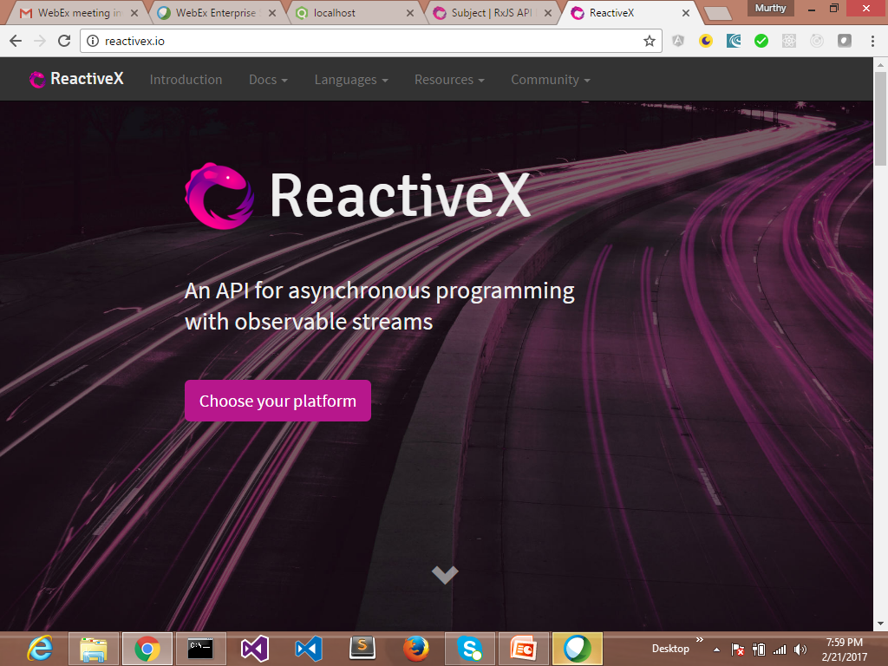
Reactivex.io/rxjs

Slide 20
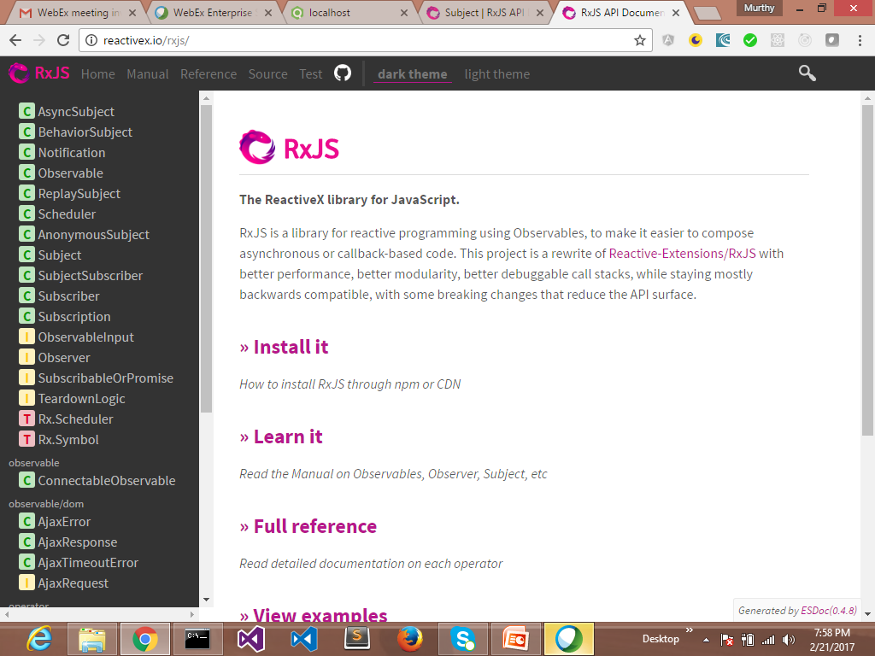
Reactivex.io/rxjs

Slide 21
Observable
let obs = Rx.Observable
.interval(1000)
.map((v) => Math.random())
.take(3);
obs.subscribe(value => console.log("Subscriber: " + value));
Output:
Subscriber: 0.14669644453458597
Subscriber: 0.5896970672476727
Subscriber: 0.09818169196770854
let observable= http.get(“stream.com”)
Observable.toPromise(resolve,reject)
observable.subscribe(…….)
Notes:
Observables are treated like arrays. Each value over time is one item in the array. This allows us to use array like methods called operators on our Observable such as map, flatmap, reduce, ect. In our service we will be using a special type of an Observable called a BehaviorSubject. A BehaviorSubject allows us to push and pull values to the underlying Observable. We will see how this will help us construct our service.
In Angular we use RxJS a polyfill/util library for the proposed Observables primitive in the next new version JavaScript. RxJS version 5 is a peer dependency with Angular. A slim Observable is used in Angular 2+ core. The slim Observable does not have many of the useful operators that makes RxJS so productive. The Observable in Angular is slim to keep the byte site of the library down. To use extra operators we import them like so: import 'rxjs/add/operator/map';.
In our example we will have a TodosService. Our todos service will have basic CRUD operations and a Observable stream to subscribe to. This example we will use a REST based API but it could be converted to a real-time socket based API with little effort. Next lets take a look at a the constructor of our service.

Slide 22


Observer & observables
Observer Monitors observable
Observable Does something

Slide 23
Observer & observables
Yum!

Slide 24
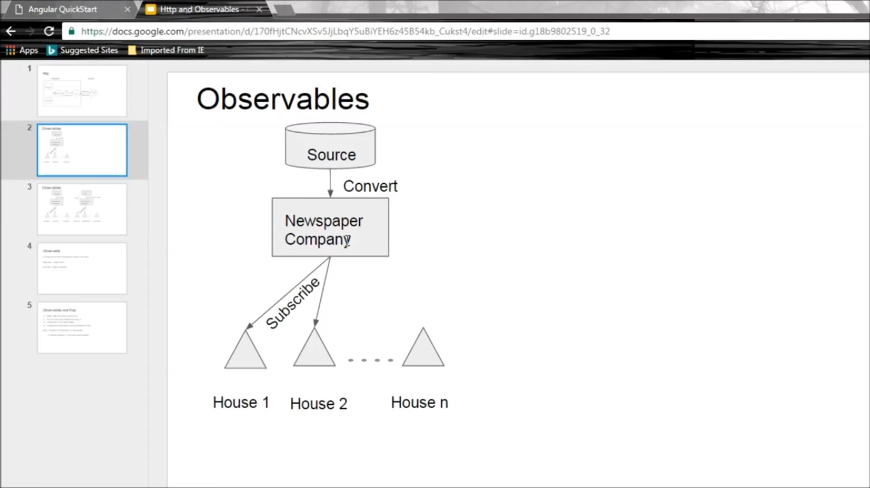

Slide 25
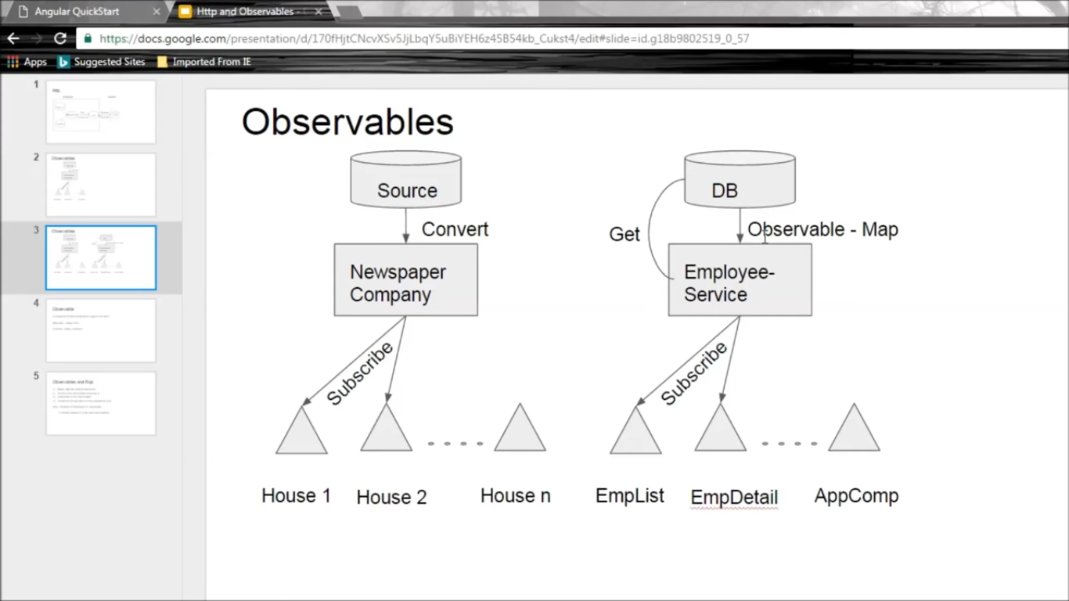

Slide 26
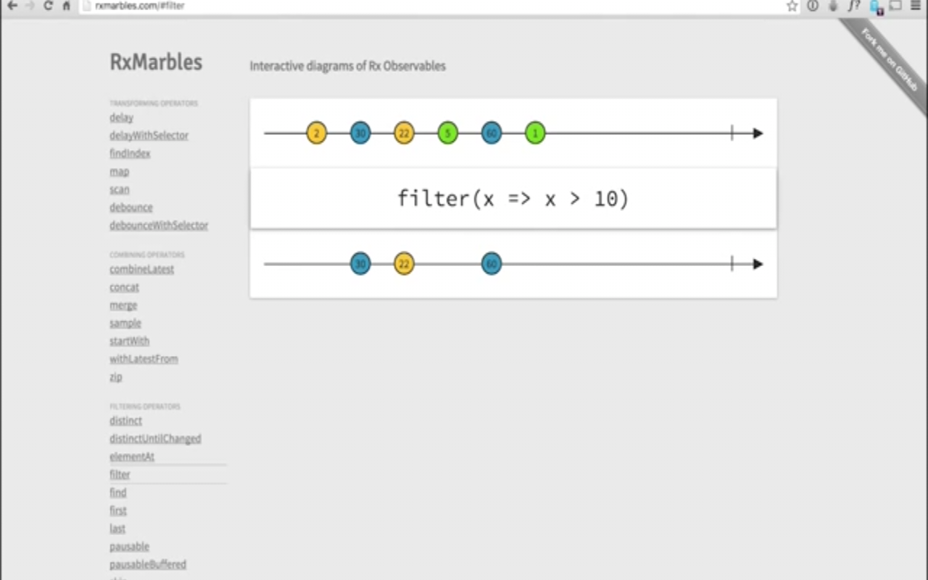
Observable
Indicates an error
X
Indicating event with value
(click)
Indicates
Stream has
completed

Slide 27
RXJS
var observer = rx.Observer.create(
function onNext(result){
console.log(result);
},
function onError(err){
console.log(err);
},
function onCompleted(){
console.log('Completed'); });
observable.subscribe(observer);

Slide 28
RXJS
Pass in observer when calling subscribe or by passing onNext, onError and onCompleted callbacks. These are their behaviours:
onNext, called for each element in the observable sequence.
onError, called only once in case of an error.
onCompleted, called only once when the stream finishes.

Slide 29
RXJS
Observable Operators
creation, conversion, combine, functional, mathematical, time, exceptions, miscellaneous, selection and primitives.
merge @, concat @, defer, do, map @, flatMapLatest, fromPromise, fromEvent, takeUntil @, throttle, delay @, empty, catch, if, timer, filter, zip @.
var obs = Rx.Observable.interval(500)
.take(5)
.do(i => console.log(i) );
obs.subscribe();

Slide 30
Observable
let obs = Rx.Observable
.interval(1000)
.take(3)
.map((v) => Date.now());
obs.subscribe(value => console.log("Subscriber: " + value));
<script src=
"https://cdnjs.cloudflare.com/ajax/libs/rxjs/4.1.0/rx.all.js"></script>

Slide 31
Angular Observable
Angular uses reactive programming and observables .
EventEmitter
Under the hood this works via Observables.
HTTP
We’ve not covered this yet but HTTP requests in Angular are all handled via Observables.
Forms
Reactive forms in Angular expose an observable, a stream of all the input fields in the form combined.

Slide 32
Observable vs Promise
Observables vs Promise: (Both for handling async data)
Observables emit multiple values over time. For example a Promise once called will always return one value or one error.
Web socket/real-time based data or event handlers can emit multiple values over any given time. This is where Observables really shine.
The new HTTP service and EventEmitter system are all Observable based.

Slide 33
Observable
Observables :
ItemsService.Items.subscribe(updatedItems => {
this.Items = updatedItems
});
…..
<!-- Async pipe is used to bind an observable -->
<div *ngFor="let item of items | async"> {{ item.value }}
<button (click)="deleteItem(item.id)">X</button>
</div>
Each time there is a new value emitted from Observable ,Angular updates the view.
Notes:
Observables are treated like arrays. Each value over time is one item in the array. This allows us to use array like methods called operators on our Observable such as map, flatmap, reduce, ect. In our service we will be using a special type of an Observable called a BehaviorSubject. A BehaviorSubject allows us to push and pull values to the underlying Observable. We will see how this will help us construct our service.
In Angular we use RxJS a polyfill/util library for the proposed Observables primitive in the next new version JavaScript. RxJS version 5 is a peer dependency with Angular. A slim Observable is used in Angular 2+ core. The slim Observable does not have many of the useful operators that makes RxJS so productive. The Observable in Angular is slim to keep the byte site of the library down. To use extra operators we import them like so: import 'rxjs/add/operator/map';.
In our example we will have a TodosService. Our todos service will have basic CRUD operations and a Observable stream to subscribe to. This example we will use a REST based API but it could be converted to a real-time socket based API with little effort. Next lets take a look at a the constructor of our service.

Slide 34
Http
Http module in Angular2 contains http service which allows to invoke server side resources like RESTful services using browser XmlHttpRequest object. (Ajax call)
http.get(url..)
http.post(url,payload)
http.put(url,payload)
http.delete(url,payload)
Load HttpModule in the angular2 project for this.

Slide 35
Server Communication – http / Web Socket
For web apps to communicate via HTTP with XMLHttpRequest (XHR) and JSONP.
Angular comes with its own built-in abstractions.
Http Client
Angular Http client to communicate via XMLHttpRequest (XHR).

Slide 36
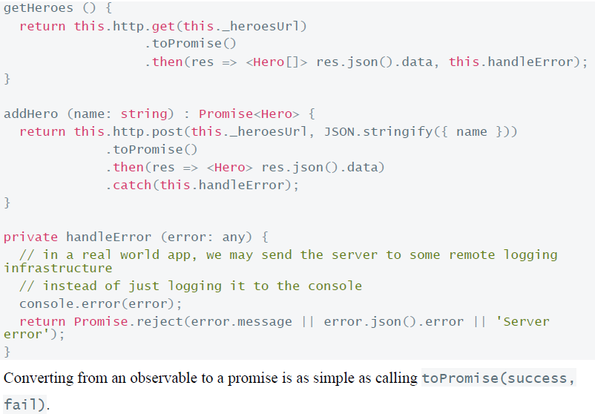
Server Communication – http / Web Socket
Converting to Promise

Slide 37
RXJS
while we are iterating over the Observable array, we are passing in a “pipe” called “async” this pipe subscribes to our Observable array and shows the data on the UI as and when the Observable delivers them on to the stream.
<h3>With async pipe</h3>
<ul>
<li
*ngFor="let filmObservable of filmsObservable | async">
{{filmObservable.title}}
</li>
</ul>

